Slide 1
Inflammation

Slide 2
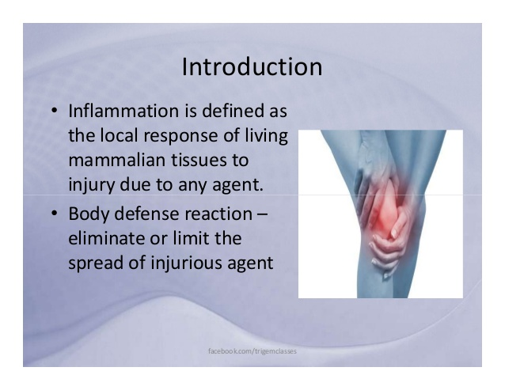

Slide 3
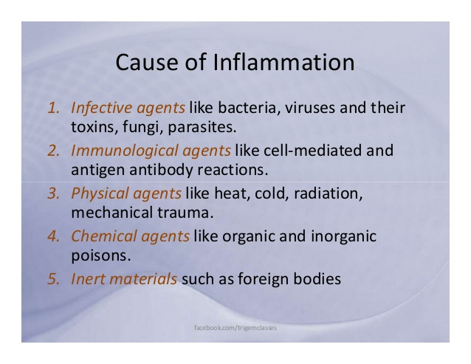

Slide 4
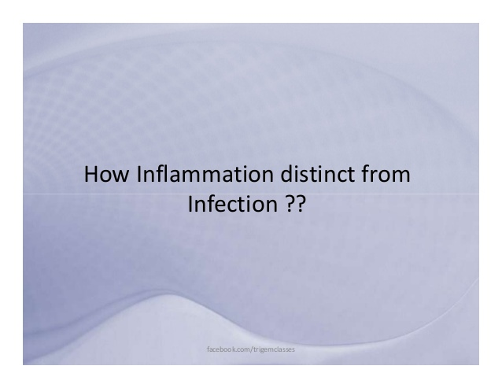

Slide 5
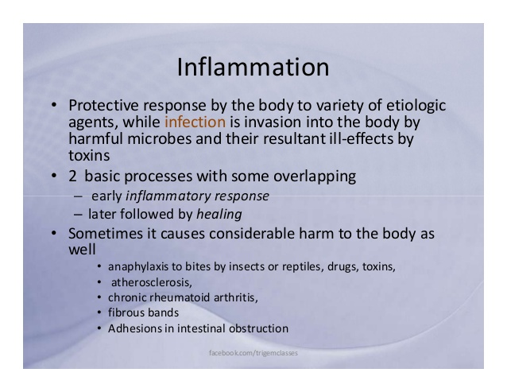

Slide 6
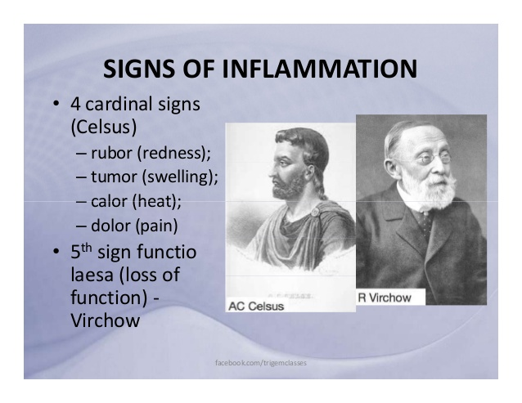

Slide 7
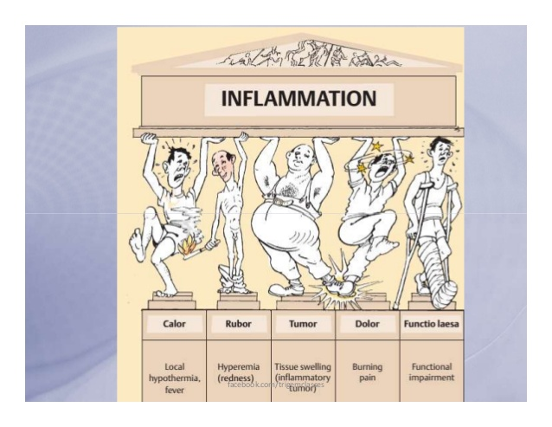

Slide 8
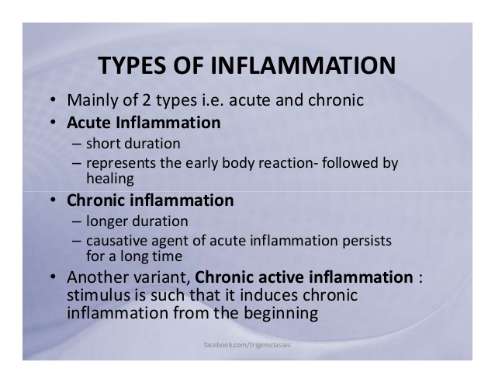

Slide 9
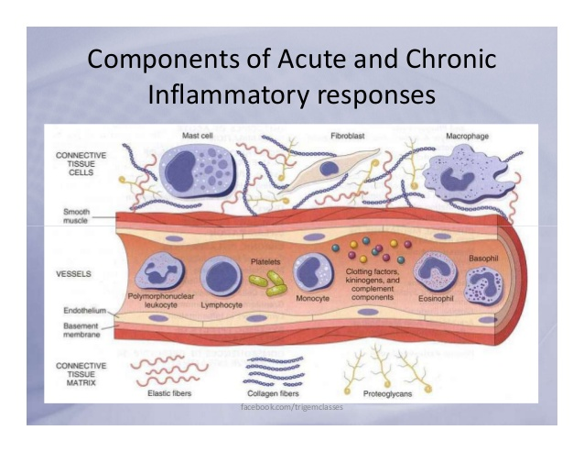

Slide 10
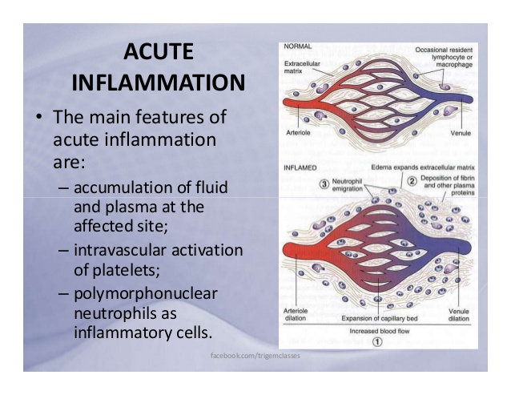

Slide 11
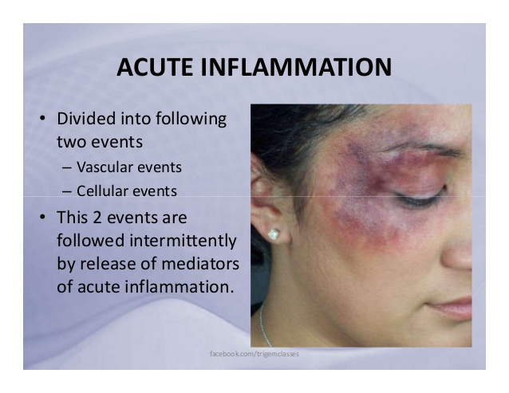

Slide 12
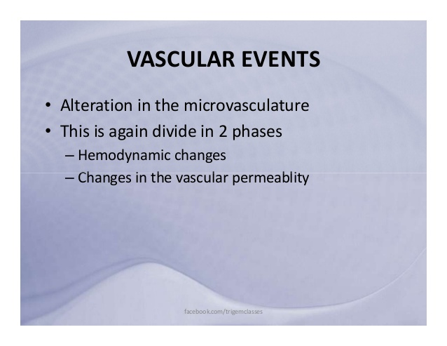

Slide 13
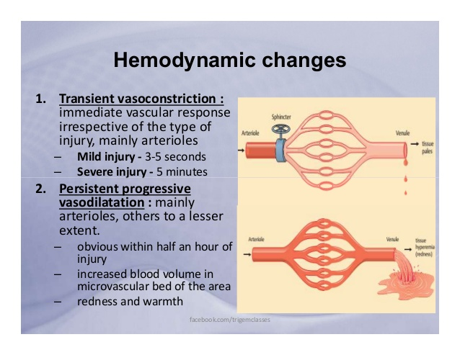

Slide 14
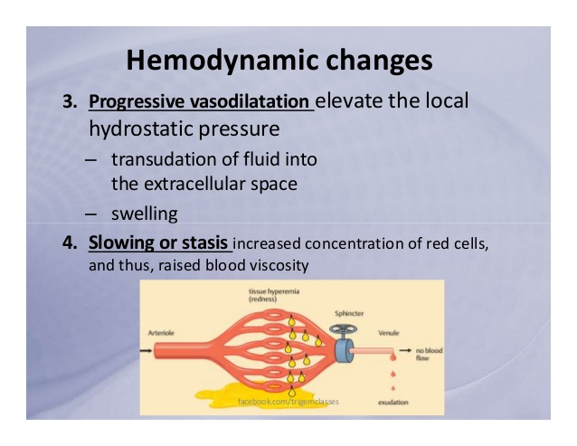

Slide 15
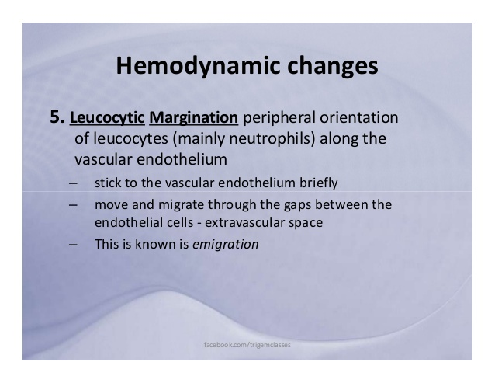

Slide 16
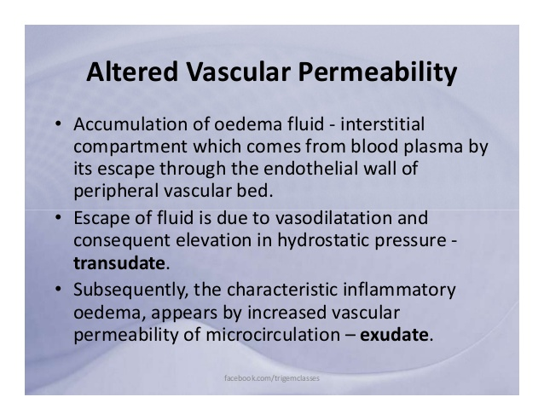

Slide 17
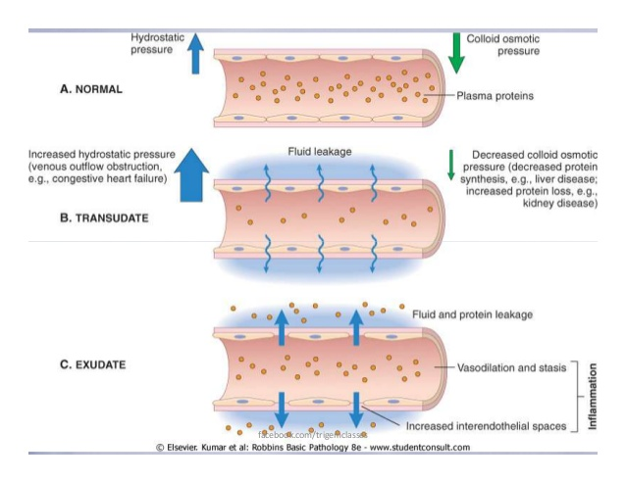

Slide 18
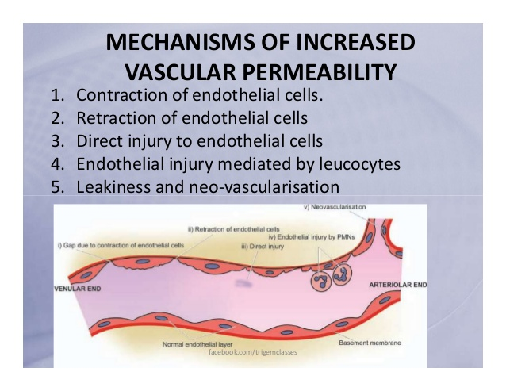

Slide 19
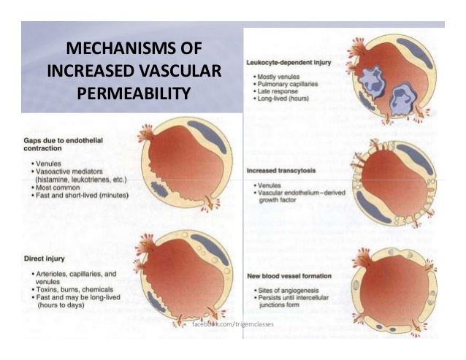

Slide 20
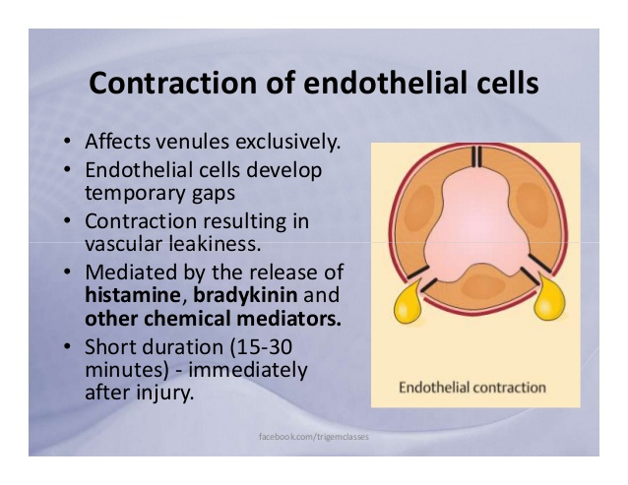

Slide 21
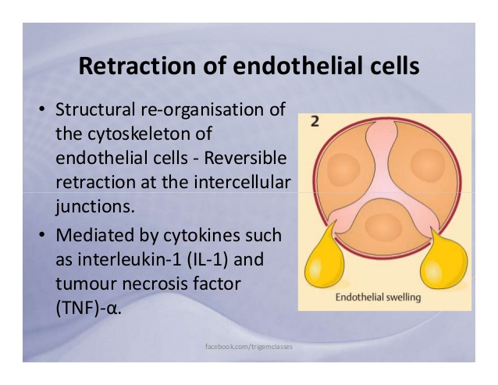

Slide 22
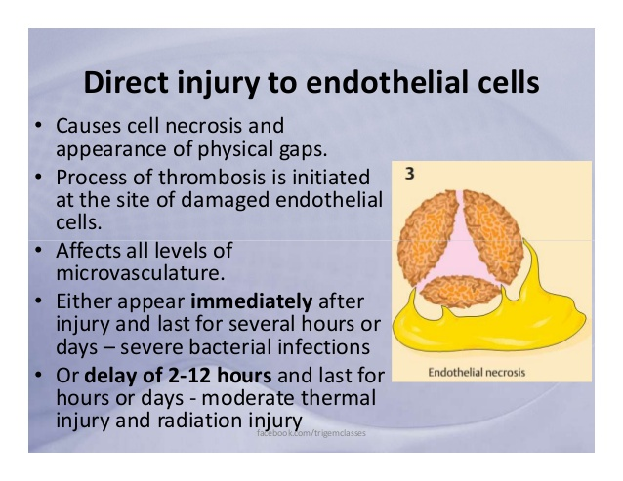

Slide 23
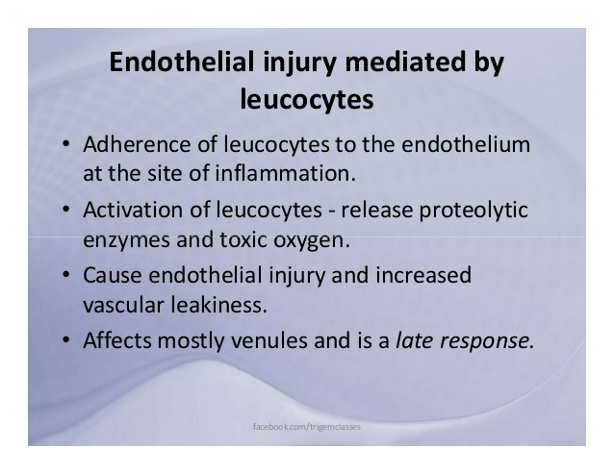

Slide 24
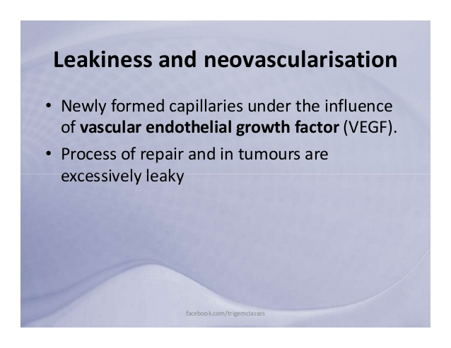

Slide 25
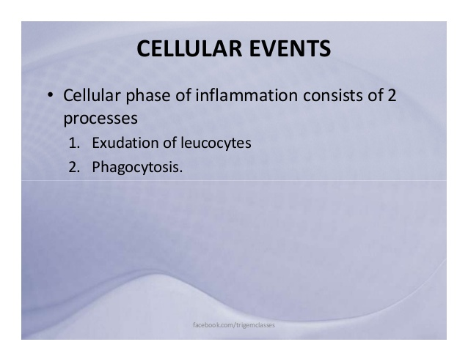

Slide 26
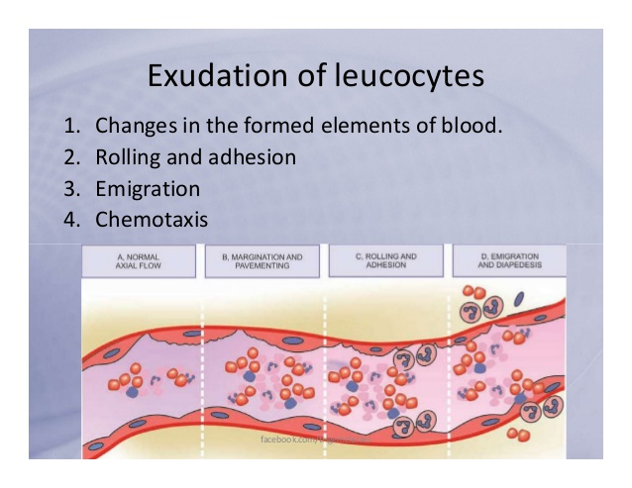

Slide 27
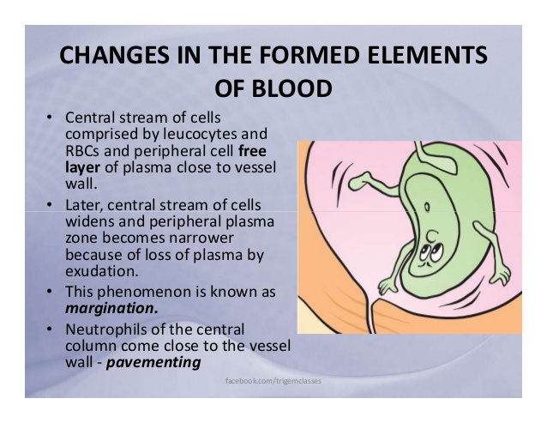

Slide 28
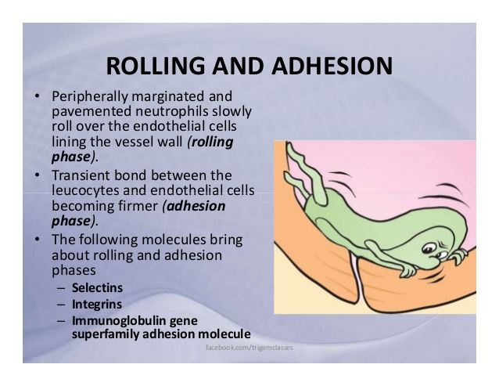

Slide 29
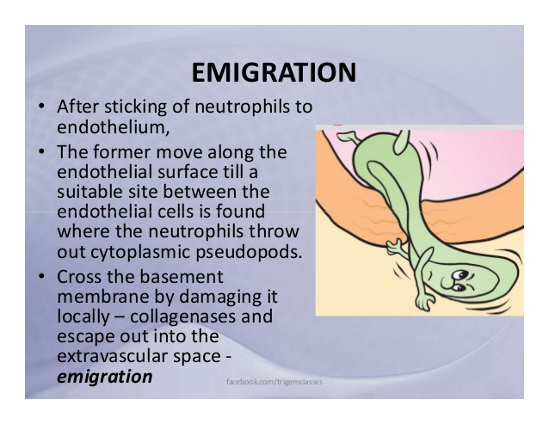

Slide 30
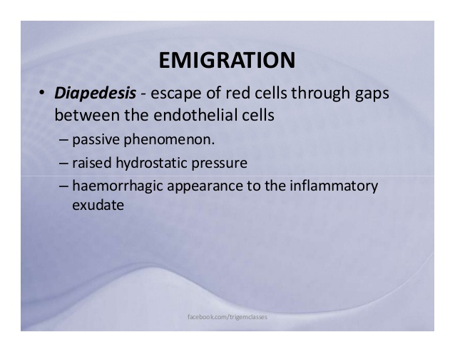

Slide 31
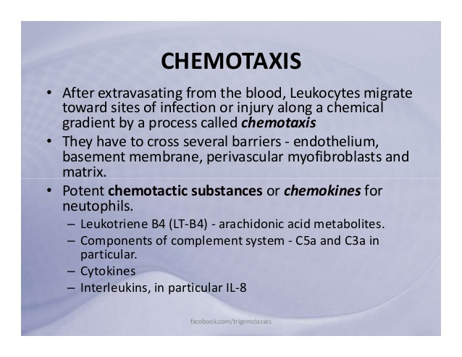

Slide 32
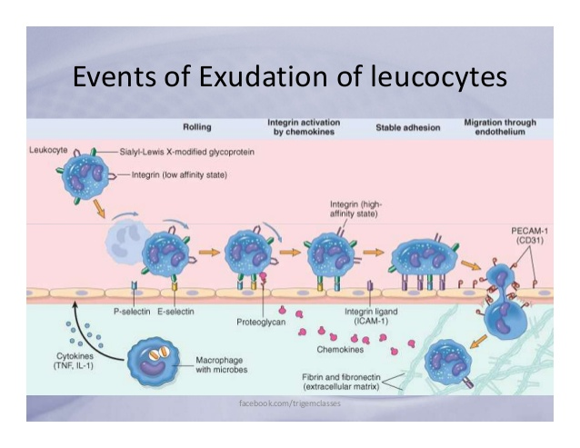

Slide 33
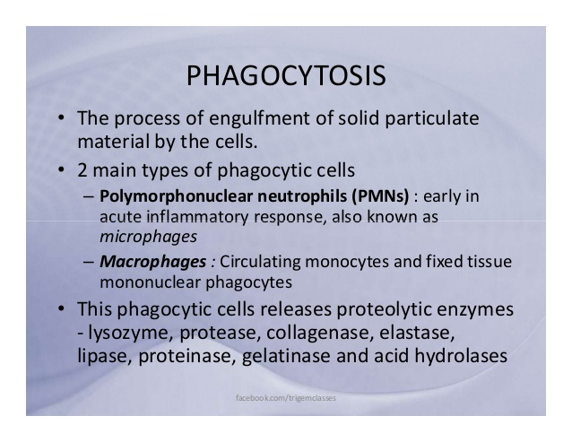

Slide 34
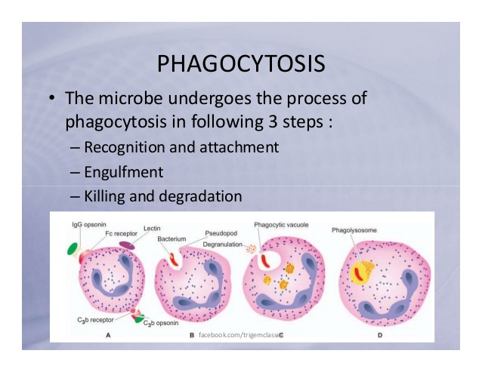

Slide 35
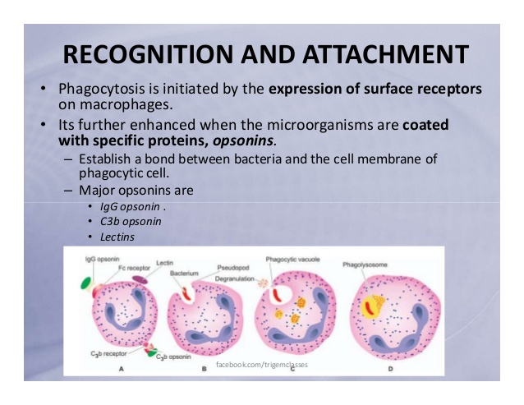

Slide 36
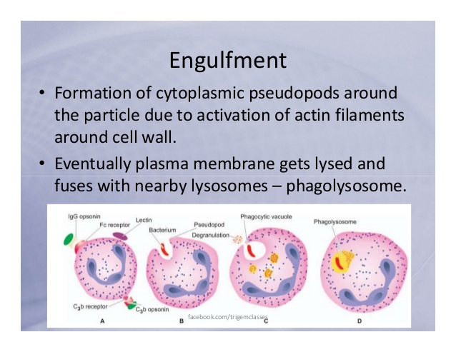

Slide 37
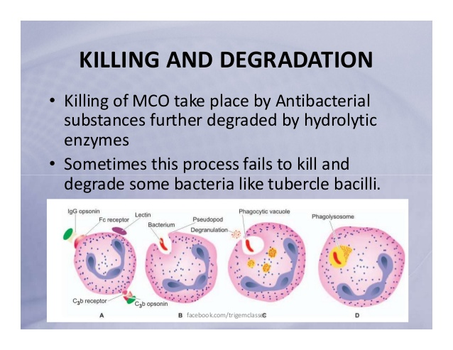

Slide 38
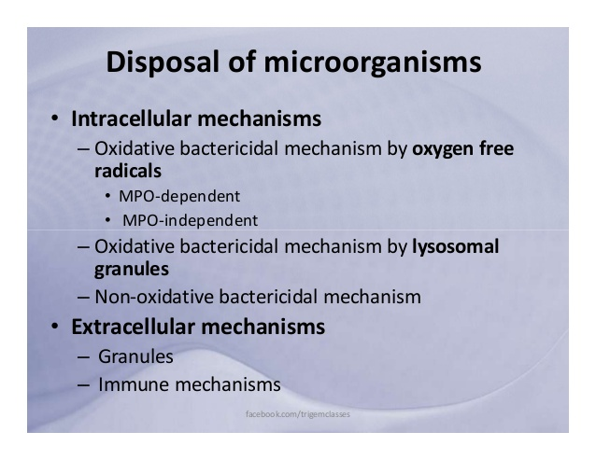

Slide 39
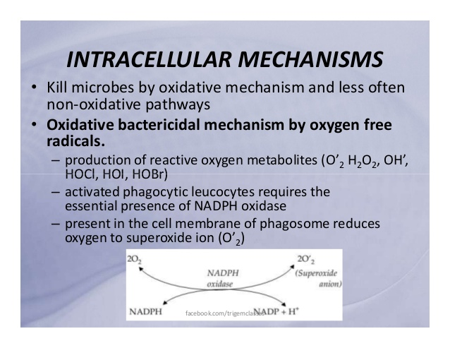

Slide 40
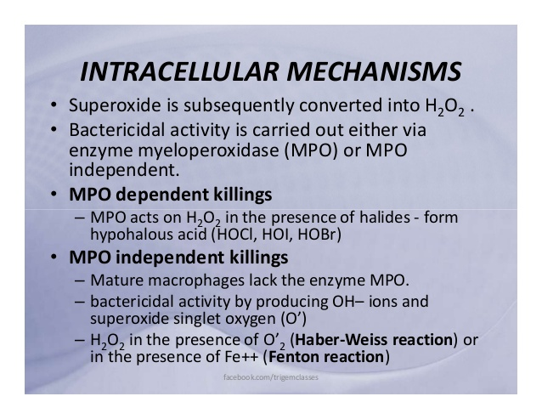

Slide 41
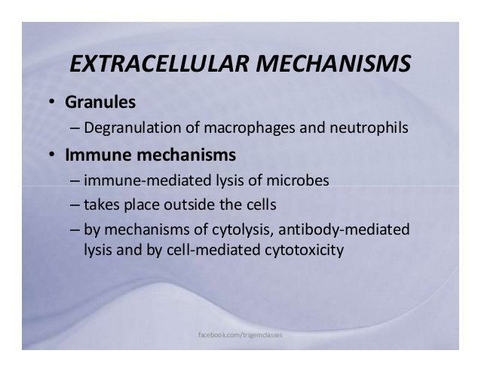

Slide 42
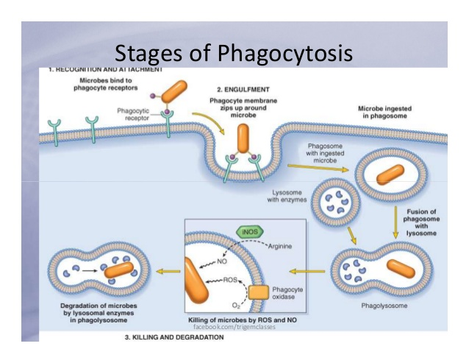

Slide 43
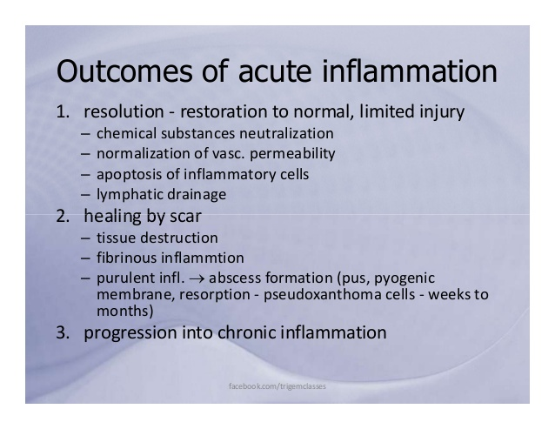

Slide 44
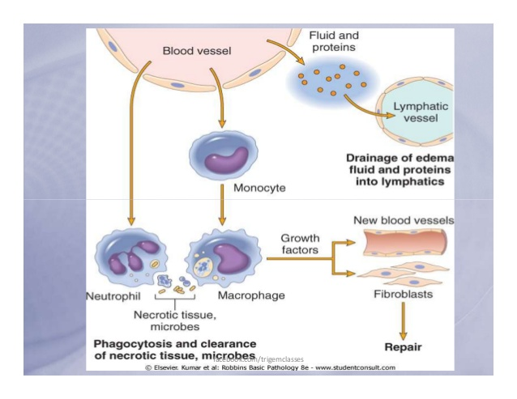

Slide 45
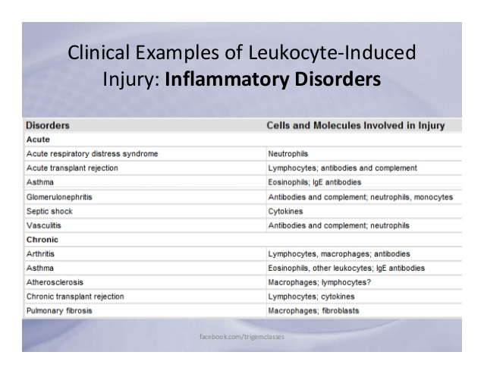

Slide 46
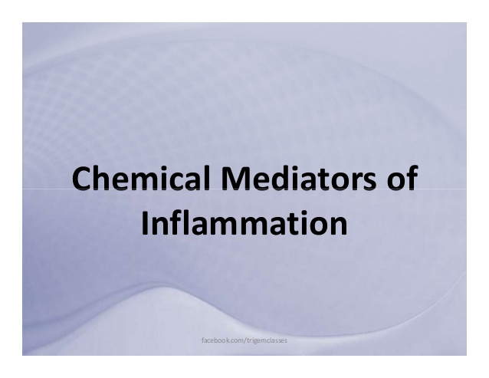

Slide 47
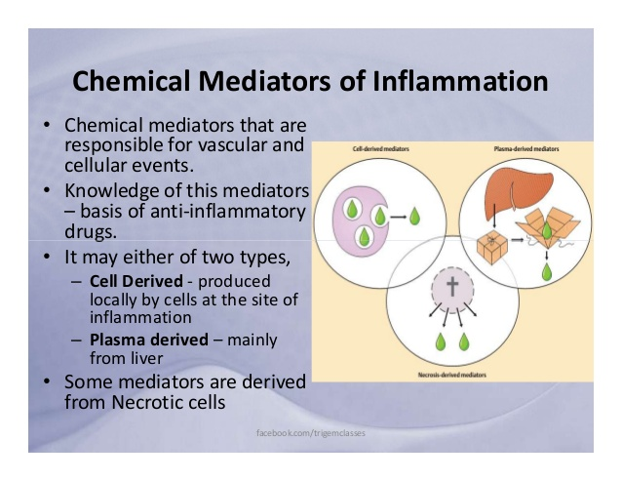

Slide 48
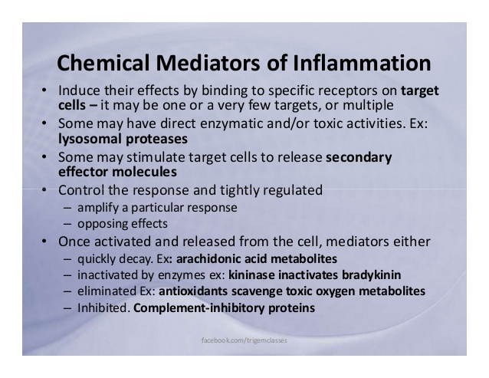

Slide 49
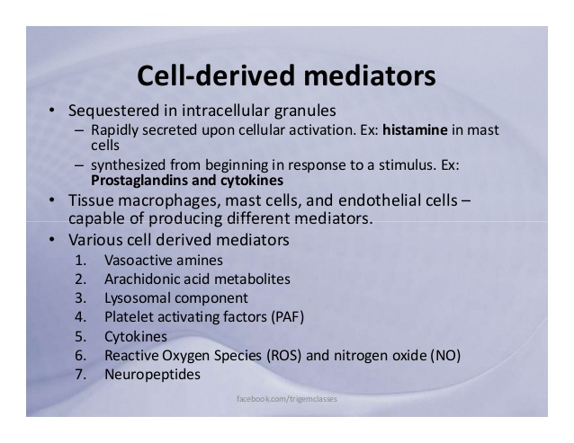

Slide 50
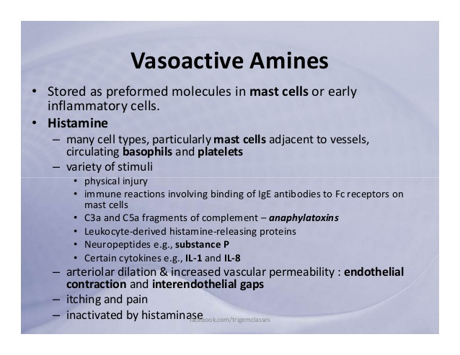

Slide 51
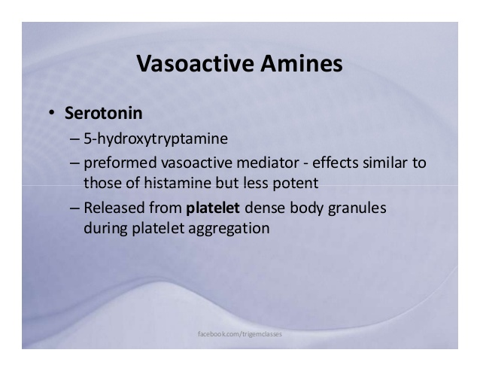

Slide 52


Slide 53


Slide 54


Slide 55


Slide 56


Slide 57


Slide 58


Slide 59


Slide 60


Slide 61


Slide 62


Slide 63


Slide 64


Slide 65


Slide 66


Slide 67


Slide 68


Slide 69


Slide 70


Slide 71


Slide 72


Slide 73


Slide 74


Slide 75


Slide 76


Slide 77


Slide 78


Slide 79


Slide 80


Slide 81


Slide 82


Slide 83


Slide 84


Slide 85


Slide 86


Slide 87


Slide 88


Slide 89


Slide 90


Slide 91


Slide 92
TYPES OF CHRONIC INFLAMMATION
Descriptive classification, histological features are used for classifying chronic inflammation into 2 corresponding types:
Chronic non-specific inflammation. It is characterised by non-specific inflammatory cell infiltration e.g. chronic osteomyelitis, lung abscess. A variant of this type of chronic inflammatory response is chronic supportive inflammation in which infiltration by polymorphs and abscess formation are additional features e.g. actinomycosis.
Chronic granulomatous inflammation. It is characterised by formation of granulomas e.g. tuberculosis, leprosy, syphilis, actinomycosis, sarcoidosis etc.

Slide 93
GRANULOMATOUS INFLAMMATION
The word ‘granuloma’ is derived from granule meaning circumscribed granule-like lesion, and -oma which is a suffix commonly used for true tumours but here it indicates a localised inflammatory mass or collection of macrophages.
Granuloma is defined as a circumscribed, tiny lesion, about 1 mm in diameter, composed predominantly of collection of modified macrophages called epithelioid cells, and rimmed at the periphery by lymphoid cells.

Slide 94
PATHOGENESIS OF GRANULOMA
The sequence in evolution of granuloma briefly outlined below:
Engulfment by macrophages
CD4+ T cells
Cytokines

Slide 95
Wound Healing

Slide 96


