Slide 1

Particle Size Analysis
By.,
DEEPTHI KODAM
Assistant Professor
St.Peter’s Institute of Pharmaceutical Sciences

Slide 2
Introduction
This presentation explores the various methods used in determining particle size, essential for numerous scientific and industrial applications.

Slide 3
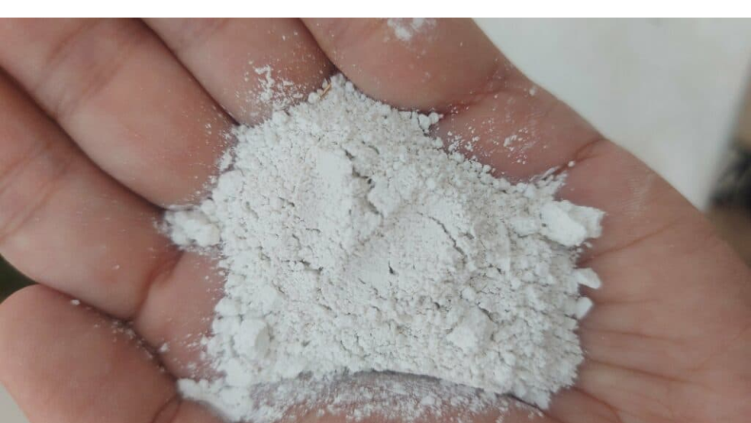

Importance of Particle Size
Particle size is critical in fields such as pharmaceuticals, material science, and environmental studies. It impacts solubility, reactivity, and stability of products.

Slide 4
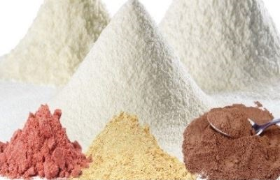
Applications of Particle Size Analysis
Particle size analysis is used in quality control, product formulation, and research. It is vital for industries like Pharmaceuticals, cosmetics, food, and chemical Industries.

Slide 5
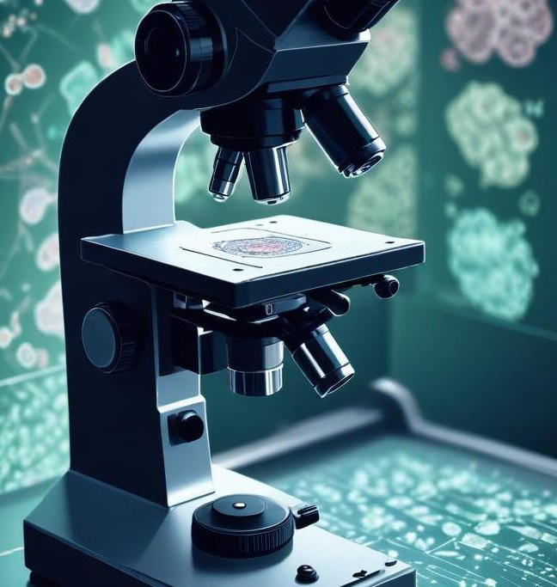
Microscopy Methods
Optical microscopy is a technique using visible light to magnify small objects, allowing for direct observation of particle size and shape in samples.

Slide 6
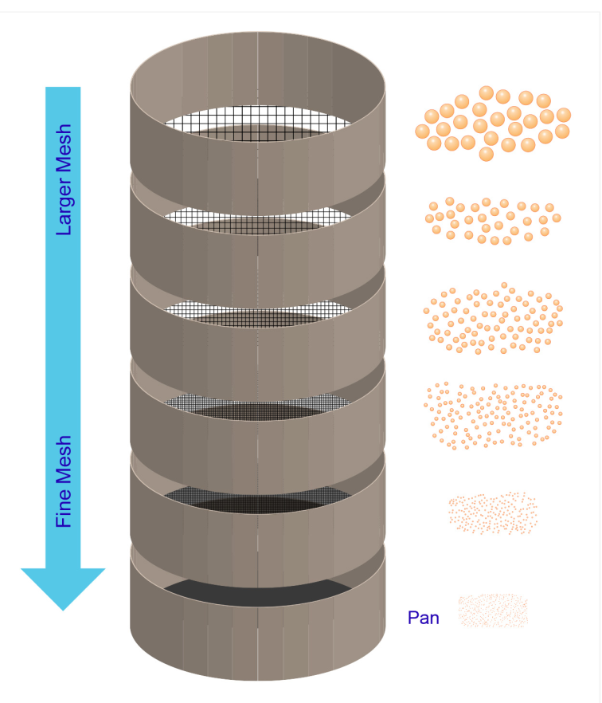
Sieve Analysis
Sieve analysis is based on the principle of separating particles by size through a series of screens or sieves with progressively smaller openings.
Standard procedures involve preparing a representative sample, stacking sieves, and shaking them to allow particles to separate based on size.

Slide 7
Conclusions
Different methods for determining particle size have unique principles and applications. Understanding these helps in selecting the appropriate technique for specific needs.

