Slide 1

SULPHONAMIDES AND SULPHONES
Dr.B.Padma
Asst. Professor
Dept. of Pharmaceutical chemistry
St Peters Institute of Pharmaceutical sciences
Hanamkonda

Slide 2
SULPHONAMIDES AND SULPHONES
Introduction
Sulfonamides (Sulphonamides) are a group of man-made (synthetic) medicines that contain the
sulfonamide chemical group. They may also be called sulfa drugs.
- Some sulfonamides are also devoid of antibacterial activity, e.g., the anticonvulsant (Sultiame). The
sulfonylureas and thiazide diuretics are newer drug groups based upon the antibacterial sulfonamides.
- The first sulfonamide was trade named Prontosil, which is a prodrug Prontosil, the first commercially
available antibacterial with a relatively broad effect (against Gram-positive cocci but not against
enterobacteria).

Slide 3
Sulphonamides can be classified in a variety of ways:
1. On the basis of the site of action
(i) Sulphonamides for general infection: Sulphanilamide, Sulphapyridine, Sulphadiazine,
Sulphamethoxacine, Sulphamethoxazole.
(ii) Sulphonamides for urinary tract infections: Sulphaisoxazole, Sulphathiazole.
(iii) Sulphonamides for intestinal infections: Phthalylsulphathiazole, Succinyl sulphathiazole,
Sulphasalazine.
(iv) Sulphonamides for local infections: Sulpahacetamide, Mafenamide, Silver sulphadiazine.
(v) Sulphonamides for dermatitis: Dapsone, Solapsone.
(vi) Sulphonamides in combination: Trimethoprim with Sulphamethoxazole.

Slide 4
2. On the basis of the pharmacokinetic properties
(i) Poorly absorbed sulphonamides (locally acting sulphonamides): Sulphasalazine,
Phthalylsulphathiazole, Sulphaguanidine, Salicylazo sulphapyridine, Succinyl sulpha thiazole.
(ii) Rapidly absorbed and rapidly excreted (systemic sulphanamides): Sulphamethoxazole,
Sulphaisoxazole, Sulphadiazine, Sulphadimidine, Sulphafurazole, Sulphasomidine, Sulphamethiazole,
Sulphacetamide Sulphachlorpyridazine.
(iii) Topically used sulphonamides: Sulphacetamide, Mafenide, Sulphathiazole, Silver sulphadiazine.

Slide 5
3. On the basis of the pharmacological activity
(i) Antibacterial agents: Sulphadiazine, Sulfi soxazole.
(ii) Drugs used in dermatitis: Dapsone.
4. On the basis of the duration of action
(i) Extra-long-acting sulphonamides (half-life greater than 50 h): Sulphasalazine, Sulphaclomide,
Sulphalene.
(ii) Long-acting sulphonamides (half-life greater than 24 h): Sulphadoxine, Sulphadimethoxine,
Sulphamethoxy pyridazine, Sulphamethoxydiazine, Sulphaphenazole, Sulphamethoxine.
(iii) Intermediate-acting sulphonamides (half-life between 10–24 h): Sulphasomizole,
Sulphamethoxazole.
(iv) Short-acting sulphonamides (half-life less than 20 h): Sulphamethiazole, sulphaisoxazole.
(v) Injectable (soluble sulpha drugs): Sulphafurazole, Sulphadiazine, Sulphamethoxine.

Slide 6
5. On the basis of the chemical structure
(i) N-1 substituted sulphonamide: Sulphadiazine, Sulphacetamide, Sulphadimidine.
(ii) N-4 substituted sulphonamides (prodrugs): Prontosil.
(iii) Both N-1 and N-4 substituted sulphonamides: Succinyl sulphathiazole, Phthalylsulphathiazole.
(iv) Miscellaneous: Mefenide sodium.

Slide 7
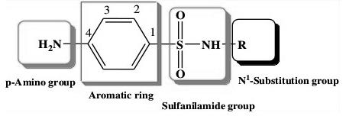
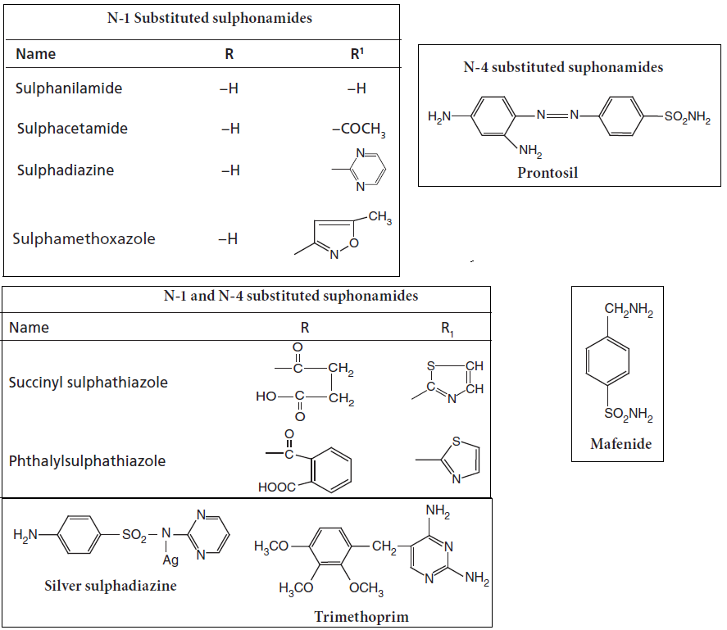
Structures of Sulfonamide derivatives

Slide 8
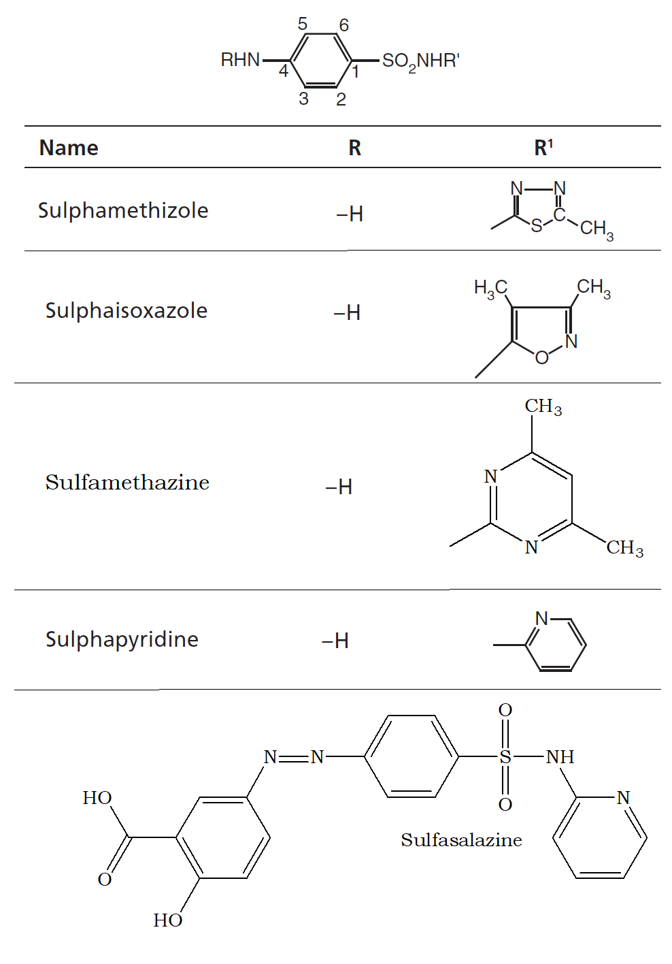

Slide 9

SAR of Sulphonamides
The major features of SAR of sulphonamides include the following:
Sulphanilamide skeleton is the minimum structural requirement for antibacterial activity.
The amino- and sulphonyl-groups on the benzene ring are essential and should be in 1 and 4 position.
The N-4 amino group could be modified to be prodrugs, which are converted to free amino function in vivo

Slide 10
Sulphur atom should be directly linked to the benzene ring.
- Replacement of benzene ring by other ring systems or the introduction of additional substituents on it decreases or abolishes its activity
- Exchange of the –SONH by –CONH reduces the activity
- On N-1-substituted sulphonamides, activity varies with the nature of the substituent at the amino
group. With substituents imparting electron-rich characters to SO
group, bacteriostatic activity increases.
- Heterocyclic substituents lead to highly potent derivatives, while sulphonamides, which contain a single benzene ring at N-1 position, are considerably more toxic than heterocyclic ring analogues
- The free aromatic amino groups should reside para to the sulphonamide group. Its replacement at
ortho or meta position results in compounds devoid of antibacterial activity.
- The active form of sulphonamide is the ionized, maximum activity that is observed between the pKa values 6.6–7.4.

Slide 11
Substitutions in the benzene ring of sulphonamides produced inactive compounds.
- Substitution of free sulphonic acid (–SO3H)
group for sulphonamido function destroys the activity, but
replacement by a sulphinic acid group (–SO2H) and acetylation of N-4 position retains back the activity
Meta-Sulphonamides bind to the basic centres of arginine, histidine, and lysine sites of proteins.
binding groups are alkyl, alkoxy, and halides. The binding affects the activity of sulphonamides; protein
protein binding appears to modulate the availability of the drug and its half-life.
- The lipid solubility influences the pharmacokinetic and antibacterial activity, and so increases the half life and antibacterial activity

Slide 12
group for sulphonamido function destroys the activity, but
replacement by a sulphinic acid group (–SOH)
and acetylation of N-4 position retains back the activity.
- Meta-Sulphonamides bind to the basic centres of arginine, histidine, and lysine sites of proteins.
binding groups are alkyl, alkoxy, and halides. The binding affects the activity of sulphonamides; protein
binding appears to modulate the availability of the drug and its half-life.
- The lipid solubility influences the pharmacokinetic and antibacterial activity, and so increases

Slide 13
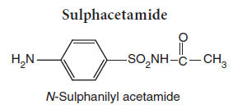
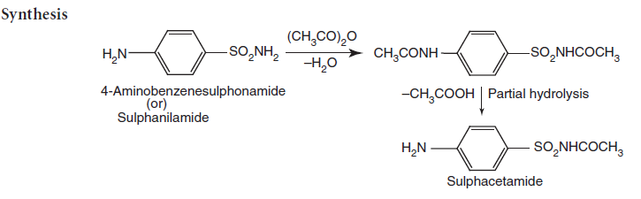
Synthesis of Sulphacetamide

Slide 14
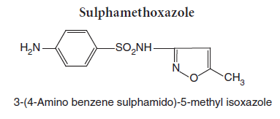
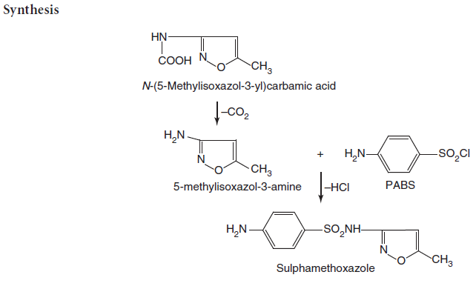
Synthesis of Sulphamethoxazole

Slide 15
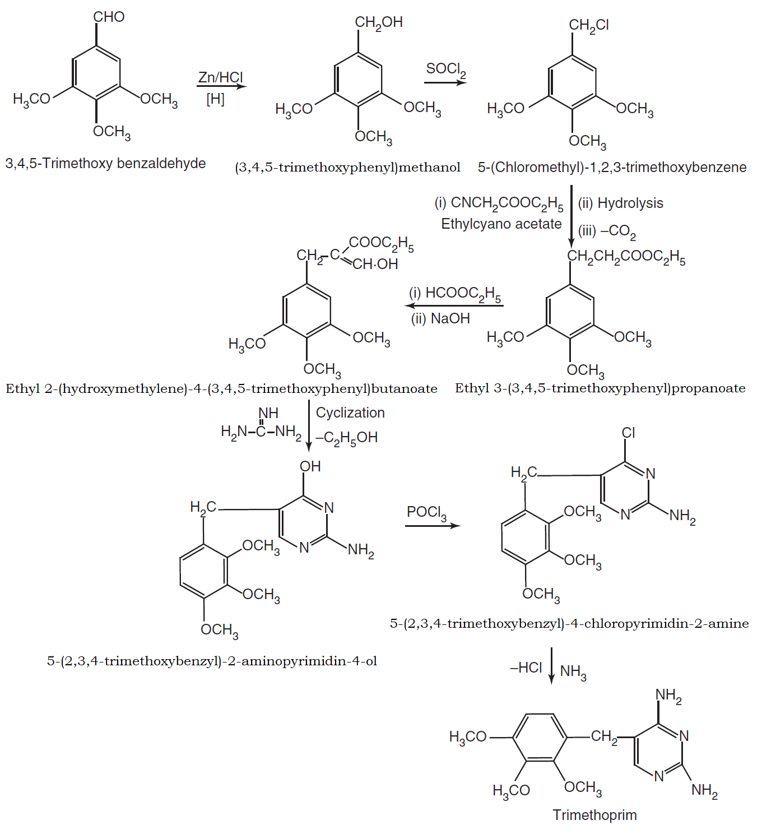
Synthesis of Trimethoprim

Slide 16
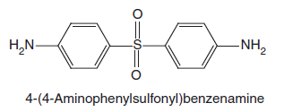
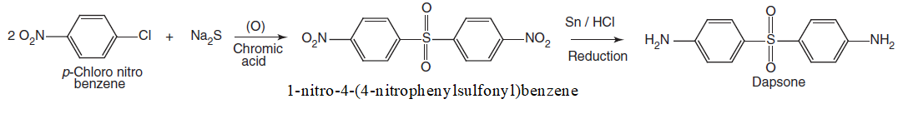
Dapsone (DDS, Diaminodiphenyl sulphone)

Slide 17
Mechanism of action: Sulfonamides & Trimethoprim
- Sulfanilamide is a competitive inhibitor of bacterial enzyme dihydropteroate synthetase. This enzyme
normally uses para-aminobenzoic acid (PABA) for synthesizing the necessary folic acid. The inhibited
reaction is normally necessary in these organisms for the synthesis of folic acid. Without it, bacteria
cannot replicate.
- Trimethoprim is a reversible inhibitor of dihydrofolate reductase, one of the principal enzymes
catalyzing the formation of tetrahydrofolic acid (THF) from dihydrofolic acid (DHF). Tetrahydrofolic
acid is necessary for the biosynthesis of bacterial nucleic acids and proteins and ultimately for
continued bacterial survival-inhibiting its synthesis, then, results in bactericidal activity. Trimethoprim
binds with a much stronger affinity to bacterial dihydrofolate reductase as compared to its mammalian
counterpart, allowing trimethoprim to selectively interfere with bacterial biosynthetic processes.
- Trimethoprim exerts a synergistic effect with sulfonamides.

Slide 18
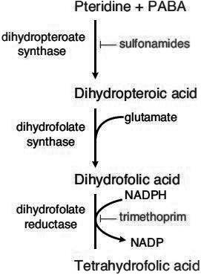
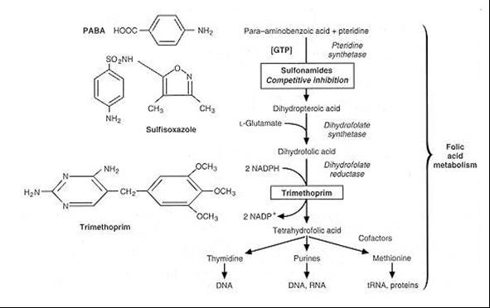
Trimethoprim is often given in combination with sulfamethoxazole, which inhibits the preceding step
in bacterial protein synthesis-given together, sulfamethoxazole and trimethoprim inhibit two
consecutive steps in the biosynthesis of bacterial nucleic acids and proteins. As a monotherapy
trimethoprim is considered bacteriostatic, but in combination with sulfamethoxazole is thought to exert
bactericidal activity

Slide 19
Side effects
- Sulfonamides have the potential to cause a variety of untoward reactions, including urinary tract
disorders, haemopoietic disorders, and hypersensitivity reactions.
- When used in large dose, it may develop a strong allergic reaction. One of the most serious is Stevens
Johnson syndrome (or toxic epidermal necrolysis).
- Some of the original sulfonamide drugs were derived from azo dyes and had the interesting effect of
temporarily turning the patient red.
- N.B- Stevens-Johnson syndrome (SJS) is a life-threatening condition affecting the skin, in which due
to cell death the epidermis separates from the dermis. The syndrome is thought to be a hypersensitivity

Slide 20
Adverse reactions
i) The most common manifestation of a hypersensitivity reaction to sulfa drugs are rash and hives.
However, there are several life-threatening manifestations of hypersensitivity to sulfa drugs,
including Stevens-Johnson syndrome, toxic epidermal necrolysis, agranulocytosis, hemolytic
anemia, thrombocytopenia, and fulminant hepatic necrosis, among others
ii) The sulfonamide antibiotic chemical structures are implicated in the hypersensitivity reactions
associated with the class.
- The first is the N1 heterocyclic ring, which causes a type I hypersensitivity reaction.
- The second is the N4 amino nitrogen that, in a stereospecific process, forms reactive metabolites that

Slide 21
Dapsone (DDS, Diaminodiphenyl sulphone)
Mechanism of action
- As an antibacterial, Dapsone inhibits bacterial synthesis of dihydrofolic acid, via competition with
para-aminobenzoate for the active site of dihydropteroate synthase.
Adverse effects
- The most prominent side-effects of this drug are dose-related hemolysis (which may lead to hemolytic
anemia) and methemoglobinemia.
- Toxic hepatitis and cholestatic jaundice.
- Other adverse effects include nausea, headache, and rash (which are common), and insomnia,
psychosis, and peripheral neuropathy

Slide 22
Uses
Dapsone is commonly used in combination with rifampicin and clofazimine for the treatment of leprosy
It is also used to both treat and prevent pneumocystis pneumonia and toxoplasmosis.
Dapsone by mouth was one of the first medications used to treat moderate to severe acne vulgaris and useful in the prevention of malaria
Dapsone also used to treat Autoimmune disease (like Cutaneous lupus erythematosus, Idiopathic
thrombocytopenic purpura, Chronic spontaneous urticaria, Relapsing polychondritis).
Dapsone also used in treatment of Dermatitis herpetiformis and generalized granuloma annulare.
Dapsone has been used as a monomer in the design of dye adsorbent polymers.

Slide 23
Trimethoprim/Sulphamethoxazole
Uses
Lung infections (pneumonia or PJP) caused by a bacterium called Pneumocystis jirovecii (previously P. carinii).
It is used for skin infections, travellers’ diarrhoea, and cholera.Infections caused by a bacterium called Toxoplasma (toxoplasmosis). Urinary bladder or urinary tract infections (water infections)
Respiratory tract infections such as bronchitis.
Ear infections such as otitis media An infection called nocardiosis which can affect the lungs, skin and brain.
It may be used both to treat and prevent pneumocystis pneumonia in people with HIV/AIDS
It can be given by orally or intravenously.
Side effects
Nausea, vomiting, rash, and diarrhoea.

Slide 24
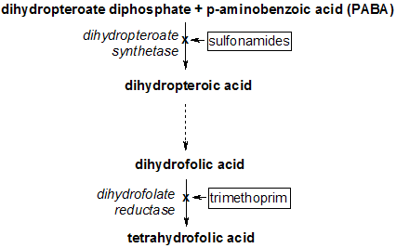
- Mechanism of Action

Slide 25
Sulphamethizole
Cystitis, Genital tract inflammation, Gonorrhea, Nephritis, Prostatitis, Urinary
Tract Infection and Vaginal Inflammation
Sulphaisoxazole
Urinary Tract Infections, Meningococcal Meningitis, Acute Otitis Media, Trachoma,
Inclusion Conjunctivitis, Nocardiosis, Chancroid, Toxoplasmosis, Malaria and
Other Bacterial Infections.
Sulfamethazine
For the treatment bacterial infections causing bronchitis, prostatitis, Bacterial
Conjunctivitis, Endometritis, Furuncle, Streptococcal Sore Throat, Ulcers and
Urinary Tract Infections.
Sulfacetamide
For the treatment of Bacterial Vaginitis, Keratitis, Acute Conjunctivitis, Acne
Vulgaris, Conjunctivitis, Trachoma, Superficial Ocular Infections and Blepharitis.
Sulphapyridine
For the treatment of Dermatitis Herpetiformis, Benign Mucous Membrane
Pemphigoid and Pyoderma Gangrenosum.

Slide 26
Sulphamethoxazole Sulfamethoxazole is indicated in combination with trimethoprim, in
various formulations, for the following infections caused by bacteria with documented
susceptibility: urinary tract infections, acute otitis media in pediatric patients
(when clinically indicated), acute exacerbations of chronic bronchitis in adults,
enteritis caused by susceptible Shigella, prophylaxis and treatment of
Pneumocystis jiroveci pneumonia, and travelers' diarrhea caused by enterotoxigenic
E. coli. Additional indications include the adjunctive treatment of cholera,
treatment of bacillary dysentery, nocardiosis, and second-line treatment of
brucellosis in combination with gentamicin or rifampicin.
Sulphadiazine
For the treatment of rheumatic fever, Nocardiosis, Plague, Plasmodium Infections,
Toxoplasmosis, Trachoma, Urinary Tract Infection, Wound Infections, Bacterial
otitis media caused by Haemophilus influenzae, Prophylaxis of Rheumatic fever
Recurrent Rheumatic fever and meningococcal meningitis.
Mafenide
Indicated for use as an adjunctive topical antimicrobial agent to control bacterial
infection when used under moist dressings over meshed autografts on excised
burn wounds (Second Degree Burns and Third-Degree Burns).
Sulfasalazine
For the treatment of Crohn's disease, Crohn's Disease (CD), Polyarticular juvenile
rheumatoid arthritis, chronic or unspecified, Proctitis, Rheumatoid Arthritis,
Severe Ulcerative Colitis, Mild Ulcerative Colitis, Moderate Ulcerative colitis

Slide 27
THANK YOU

